Slide 1
Introduction to Artificial Intelligence

Slide 2
This course provides an overview and introduction to the field of Artificial Intelligence. It will introduce the domain of Artificial Intelligence and the working of intelligent Systems. General understanding of major concepts and approaches in knowledge representation, searching, agents, machine learning, robotics and other AI areas will also be discussed.

Slide 3
AI currently encompasses a huge variety of subfields
From general-purpose areas such as perception and logical reasoning, to specific tasks such as:
playing chess,
proving mathematical theorems,
writing poetry,
and diagnosing diseases.

Slide 4
Introduction
Work started in earnest soon after World War II
The name itself was coined in 1956
Attempts to understand intelligent entities
AI strives to build intelligent entities as well as understand them

Slide 5
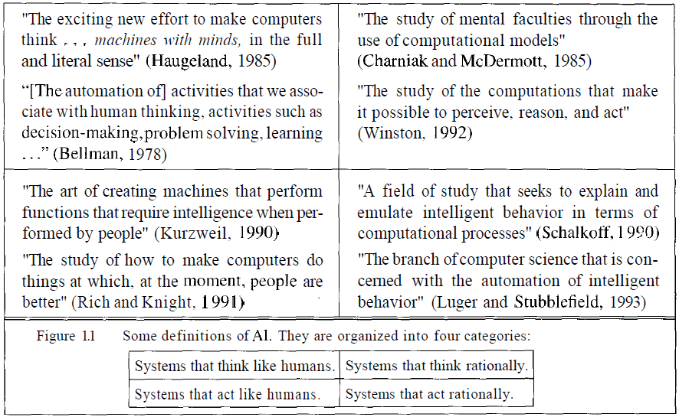

Slide 6
Acting Humanly: Turing Test
The Turing Test was proposed by Alan Turing (1950)
Operational definition of intelligence
The computer should be interrogated by a human via a teletype, and passes the test if the interrogator cannot tell if there is a computer or a human at the other end.
Turing deserves credit for designing a test that remains relevant 60 years later

Slide 7
For now, programming a computer to pass the test provides plenty to work on.
The computer would need to possess the following capabilities:
natural language processing to enable it to communicate successfully in English (or some other human language);
knowledge representation to store information provided before or during the interrogation;
automated reasoning to use the stored information to answer questions and to draw new conclusions;
machine learning to adapt to new circumstances and to detect and extrapolate patterns.

Slide 8
Total Turing Test
Turing's test deliberately avoided direct physical interaction between the interrogator and the computer
The test can be extended to include video signals, as well as “hatch” through which objects can be passed; this would force the machine to demonstrate the skills of vision and robotics.
To pass the total Turing Test, the computer will need:
computer vision to perceive objects, and
robotics to move them about.

Slide 9
Thinking Humanly: Trying to understand and model how the human mind works
Thinking humanly means cognitive modelling. We need to get inside the actual workings of human minds. It can be achieved through three different ways
Catch our thoughts: that is trying to catch our own thoughts as they go by
Psychological experiments: that is observing a person in action
Brain imaging: by observing the brain in action
Cognitive modeling is an area of computer science that deals with simulating human problem-solving and mental processing in a computerized model.

Slide 10
Thinking Rationally
Rational means it does the right thing given what it knows.
Reasoning process
Socrates is a man
all men are mortal;
therefore Socrates is mortal

Slide 11
Acting Rationally
Rational agents which can operate autonomously, perceive their environment, persist over a certain time period, adaptive and be able to create and pursue goals.

Slide 12
Foundations of AI
Philosophy
Mathematics
Psychology
Computer Engineering
Linguistics

Slide 13
History of Artificial Intelligence
Warren McCulloch and Walter Pitts (1943)
Model of artificial neurons
Marvin Minsky and Dean Edmonds, built the first neural network computer in 1950
Early enthusiasm, great expectations (1952-1969)
The return of neural networks (1986—present)

